Slide 1
COMP1860: Building Our Digital World Computer Systems & Architecture
S1.W5.L1 Hardware Description Language
& Computer Aided Design LAB 1

Slide 2
Learning Outcomes
Analyse and design a combinational logic circuit
Utilize a hardware simulator to design, test, and analyze the behavior of a digital circuit.
Implement and debug a combinational logic circuits using HDL.

Slide 3
Text Book
  Nand2Tetris HDL Guide / Documentation:
  The Elements of Computing Systems / Appendix 2: HDL

Slide 4
Overview
Introduce Computer Aided Design (CAD) and Hardware Description Language (HDL)
Introduce a hardware simulator
Learn how to write HDL files
Learn how to run simulations of simple logic circuits
Start building the chips for the Hack computer

Slide 5
CAD
Computer Aided Design (CAD) refers to the process of design and testing of systems using computers
CAD may automate some of the design and testing process
Helps to ensure that the design conforms to a specification
Encourages reuse of common components
Often supports simulations

Slide 6
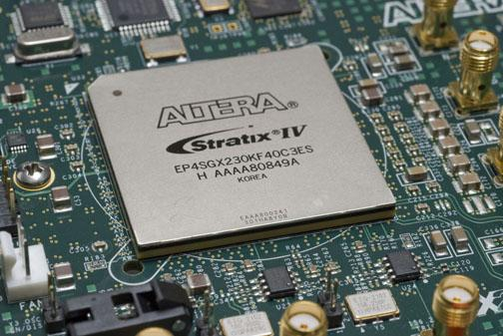
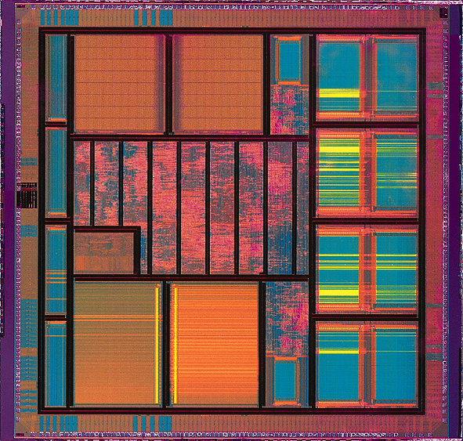
Hardware Description Language
Hardware Description Language (HDL) is a language used to specify（指定） the structure or behaviour of a digital circuit
HDL specification can be simulated（模拟）, and the specified circuit can then be evaluated（评估） against a range of tests to ensure compliance to a specification（符合规范）
HDL can often be synthesised onto(合成到) a Field Programmable Gate Array (FPGA) or a dedicated（专用） integrated circuit (e.g. fabricated on a silicon die)
By Altera Corporation - Altera Corporation, CC BY 3.0, https://commons.wikimedia.org/w/index.php?curid=6642224
CC BY-SA 3.0, https://commons.wikimedia.org/w/index.php?curid=1340494

Slide 7
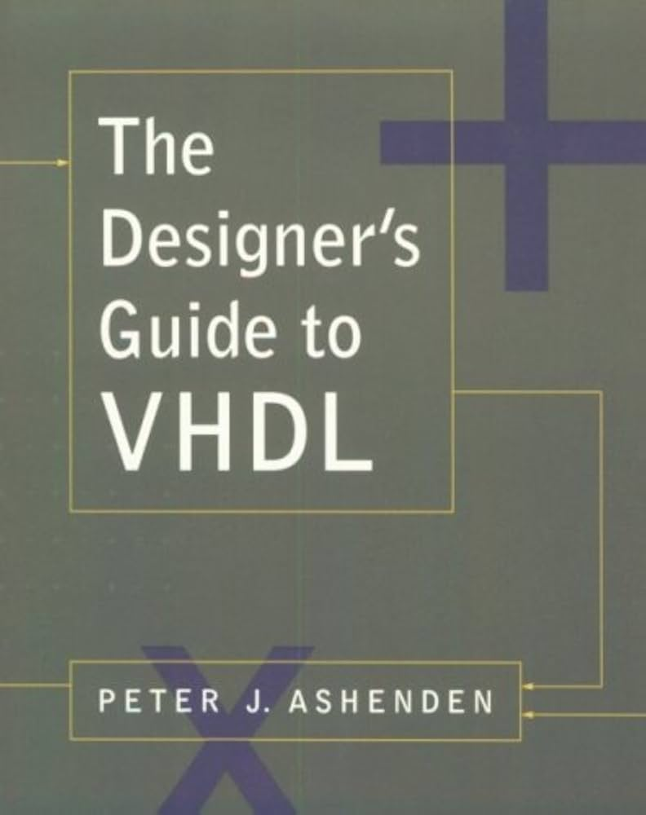
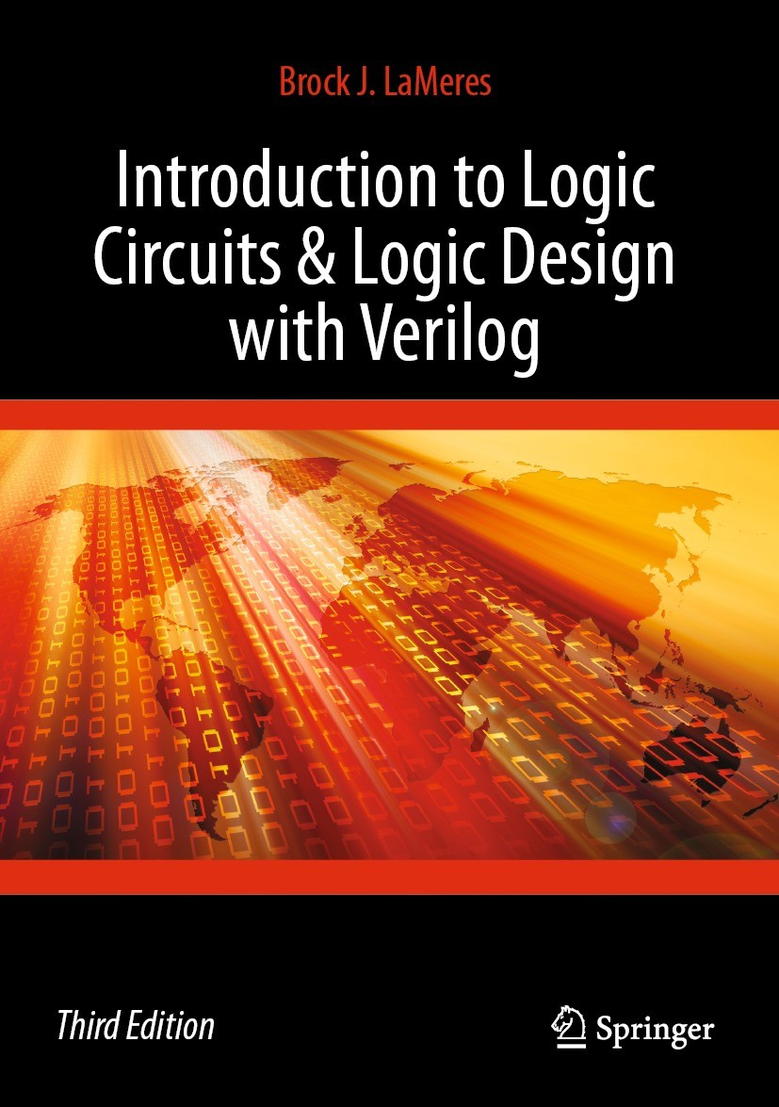
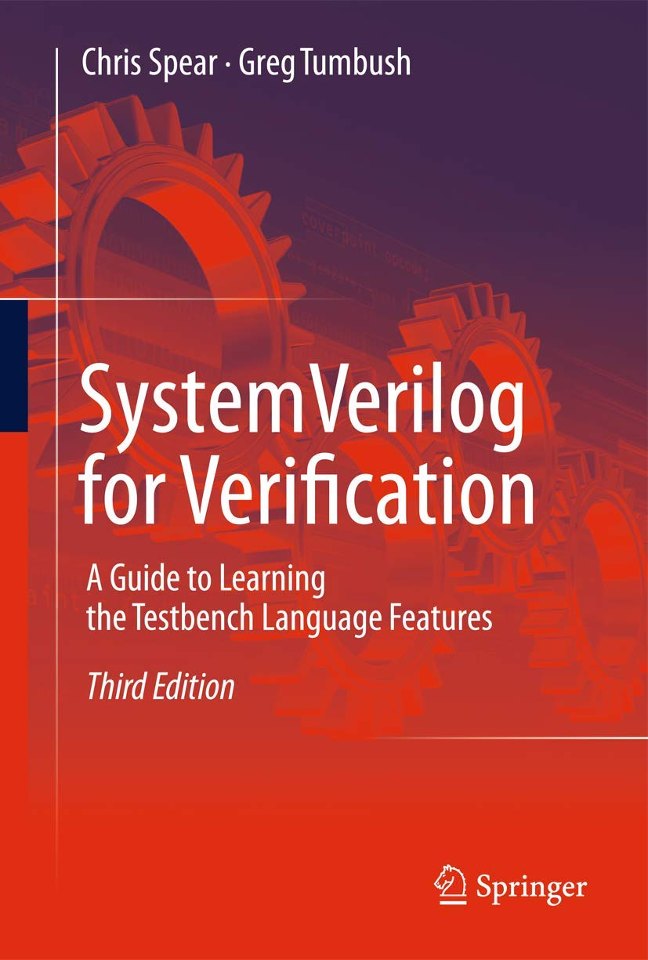
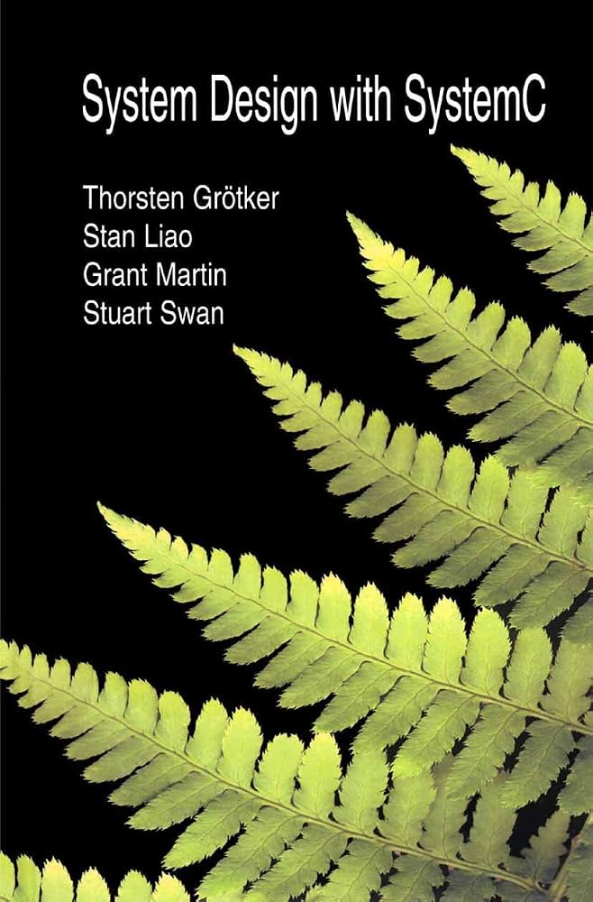
Hardware Description Language
Hardware Description Languages are widely used in industry and have evolved over the past four decades
Commonly used HDLs include VHDL, Verilog, SystemVerilog, SystemC
      Throughout this module, we will use a didactic language which we will refer simply as Hardware Description Language, or HDL

Slide 8
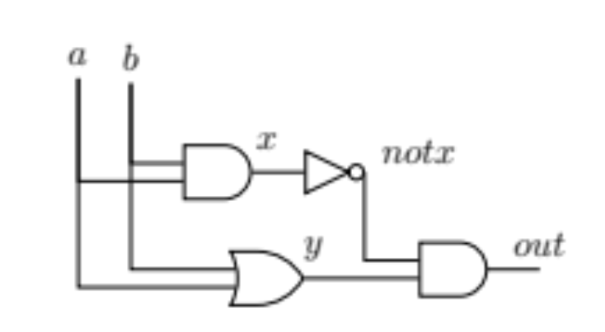
Hardware Description Language
HDL models can define the internal structure of a circuit and typically consist of 2 parts
  A header section - defining the interface of the circuit
  A parts section - defining the names and internal topology
/**
* Xor gate.
*/
CHIP Xor {
IN a, b;
OUT out;
PARTS:
And (a=a, b=b, out=x);
Or (a=a, b=b, out=y);
Not (in=x, out=notx);
And (a=y, b=notx, out=out);
}
Header
定义芯片外引脚
芯片内
Parts：定义芯片内元器件和其输入输出
  Nand2Tetris HDL Guide / Documentation:
  The Elements of Computing Systems / Appendix 2: HDL

Slide 9
HDL文件格式
/**
* 注释
*/
CHIP 芯片名 {
IN a, b; // 芯片外输入引脚（pin）
OUT out; // 芯片外输出引脚（pin）
PARTS: // 定义芯片内的元器件和元器件输入
And (a=a, b=b, out=x); // 引入一个And gate和它的输入输出引脚
Or (a=a, b=b, out=y); // 引入一个Or gate和它的输入输出引脚
Not (in=x, out=notx); // 引入一个Not gate和它的输入输出引脚
MyHalfAdd(a=a, b=b, s=s, c=c) // 引入自己的半加器芯片
And (a=y, b=notx, out=out); //芯片内的最终输出要和芯片外的输出对应
}
// 常见gate模拟器都已经内置，自己写的芯片HDL文件可放同目录下，用文件名引用

Slide 10
Defining a chip in HDL
Each chip is defined in a separate text file
A chip called Xxx is defined in a file called Xxx.hdl (大小写敏感!!)
Keywords are capitalised（大写）
Identifier name may be any sequence of letters and digits not starting with a digit (no underscores)
Whitespace has no meaning（空格没有意义）
Lines end with semicolons（行末用；结束）
Comments are provided in a variety of way
/**
* Xor gate.
*/
CHIP Xor {
IN a, b;
OUT out;
PARTS:
And (a=a, b=b, out=x);
Or (a=a, b=b, out=y);
Not (in=x, out=notx);
And (a=y, b=notx, out=out);
}
注释
关键字
// Comments to end of line
/* Comment until closing */
/** API documentation */
Xor.hdl
Identifiers
Keywords
Comments

Slide 11
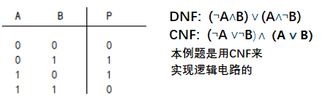
Defining a chip in HDL
Internal chip parts（内部芯片部件）
  parts pin name = chips pin name
Internal pins（内部引脚）
  Visible only within the chip（芯片内可见）
  No need to define them, they are generated when required
/**
* Xor gate.
*/
CHIP Xor {
IN a, b;
OUT out;
PARTS:
And (a=a, b=b, out=x);
Or (a=a, b=b, out=y);
Not (in=x, out=notx);
And (a=y, b=notx, out=out);
}
Xor.hdl
Part pin
Internal pins

Slide 12
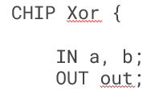
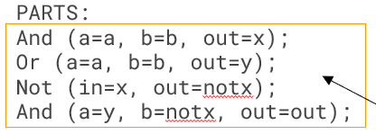
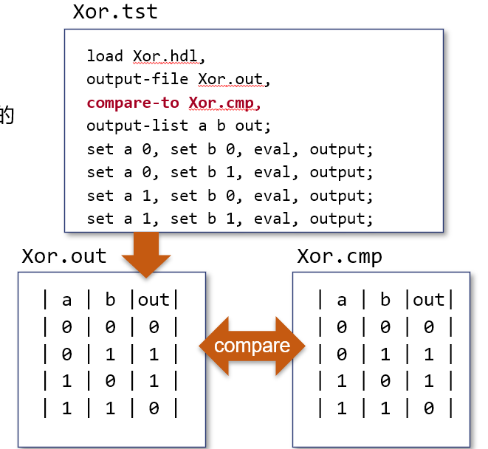
如何设计一个Chip
定义chip外部的input和output引脚
写出Chip的真值表、DNF/CNF
用Kmap化简逻辑表达式（选DNF还是CNF，主要看哪个更简单）
4. 在Parts:里面实现逻辑表达式
5. 编写script，测试真值表

Slide 13
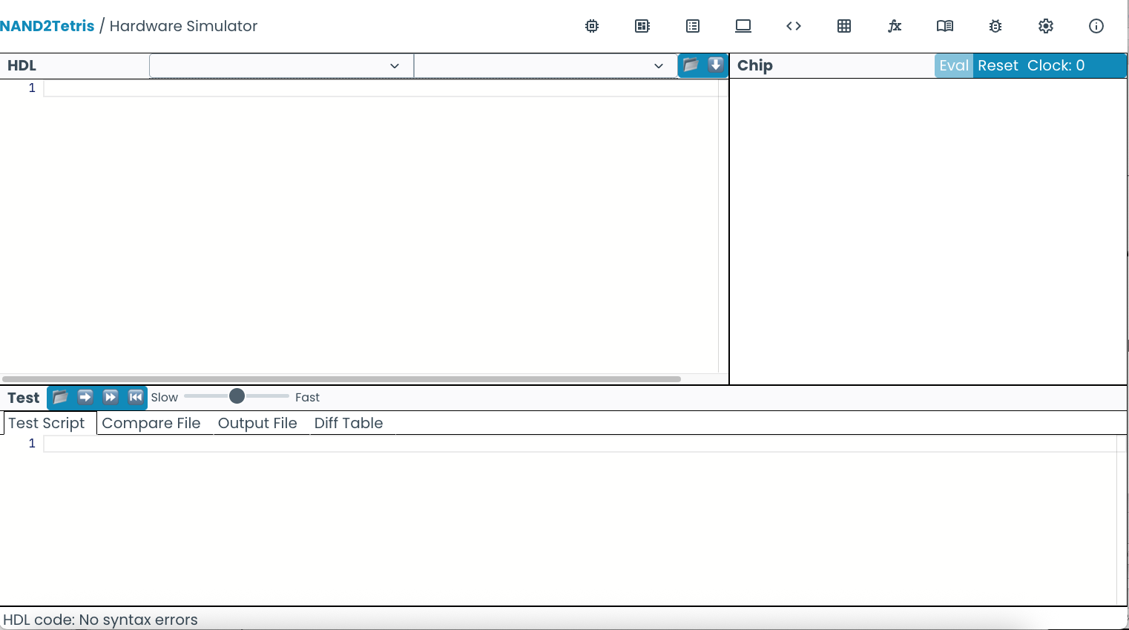

Hardware Simulator
(Works in Chrome or Edge not FireFox)​
In your web Browser goto https://nand2tetris.github.io/web-ide/chip/ to launch the new Integrated Development Environment for Nand2Tetris.

Slide 14
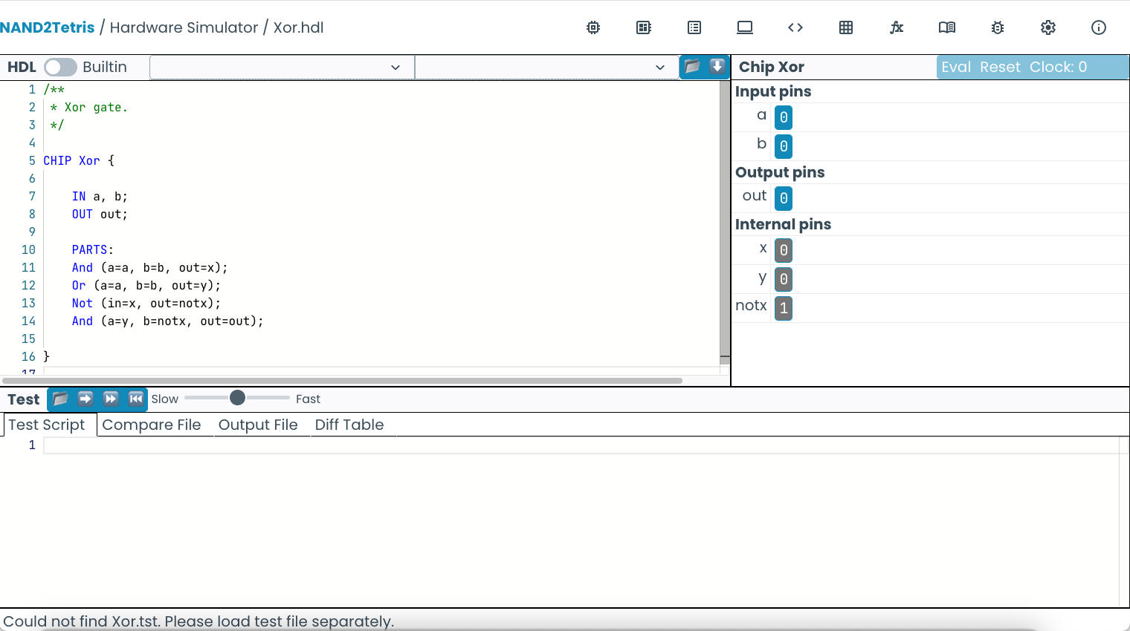
Interactive Simulation
1. Load an HDL program
3. evaluate the chip logic
2. manipulate
input pins
4. inspect
output pins
HDL code
5. inspect
internal pins

Slide 15
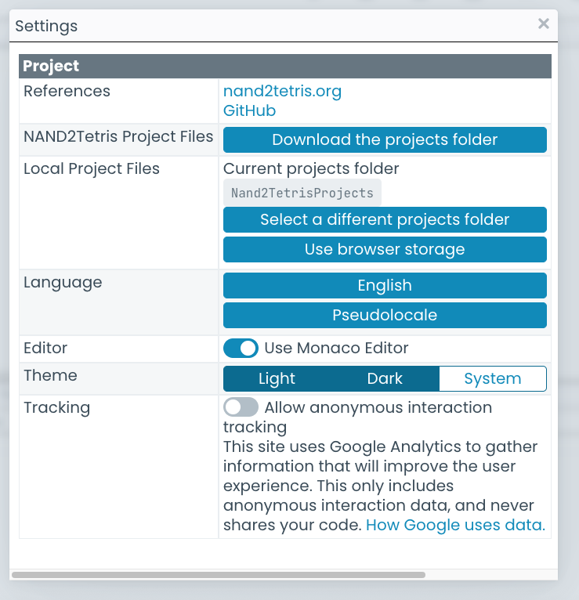

Hardware Simulator
默认情况下，此设置仅允许您处理与本书相关的项目，但我们可以更改此设置，以允许我们也处理自己的项目。
To do this
Click settings
Click Select projects folder and select or create the folder wish to store your projects in.这应该是您下载COMP1860第一学期文件的文件夹.
Close Settings
不幸的是，您不能在模拟器中从头开始创建新文件，文件必须已经存在于您的文件夹中.
要直接打开HDL文件，您现在可以选择文件夹符号

Slide 16
Obtaining the COMP1860 files
You can obtain the files you need from Minerva, under Learning Resources.
The files required for each week can be found in the folder for that week.

Slide 17
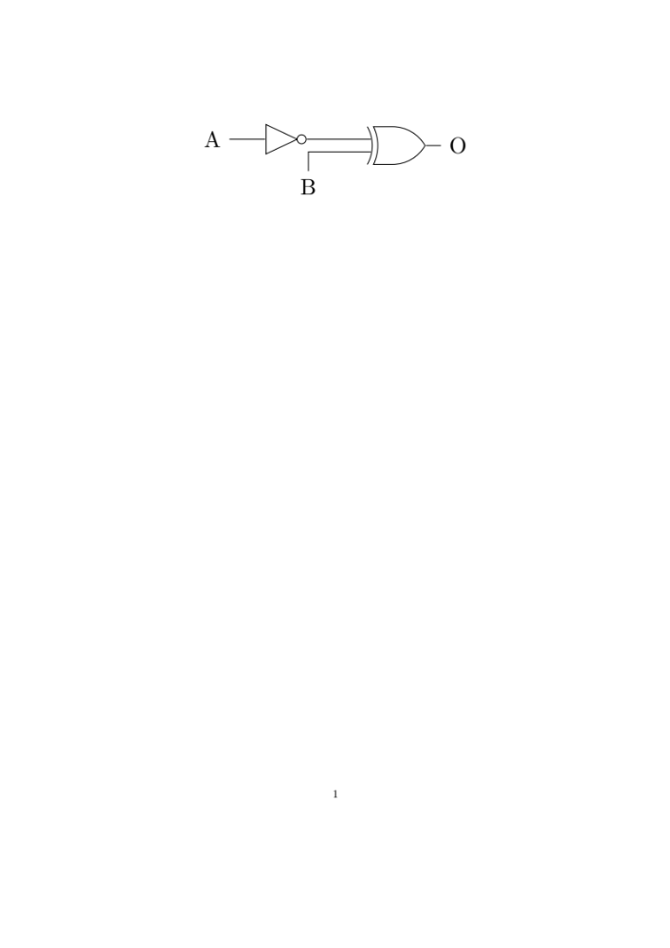
Your turn
Create an HDL file for the following circuit.
The chip should be called first and therefore the filename must be first.hdl. We have provided an empty file for you with the correct name. The case of the letters matters. The filename and chip name must match exactly.
Click on the folder symbol to open the file first.hdl and then add the contents for your HDL in the HDL window in the simulator.
If you prefer, you can also create and edit files in a text editor such as Visual Studio Code.

Slide 18
Your turn
一旦你创建了HDL代码，我们需要测试你的芯片是否在模拟中工作。
将你的第一个.hdl代码加载到模拟器中，看看它是否为不同的输入值产生了预期的输出
您可以单击输入引脚的值，在0和1之间切换它们的值，然后单击Eval以获得输出。
检查芯片是否为A和B的输入值的每种可能组合产生了正确的O值。
| A | B | O |
| 0 | 0 | 1 |
| 0 | 1 | 0 |
| 1 | 0 | 0 |
| 1 | 1 | 1 |

Slide 19
Script-based Testing
Xor.hdl
Xor.tst
CHIP Xor {
IN a, b;
OUT out;
PARTS:
Not (in=a, out=nota);
Not (in=b, out=notb);
And (a=a, b=notb, out=aAndNotb);
And (a=nota, b=b, out=notaAndb);
Or (a=aAndNotb, b=notaAndb, out=out);
}
load Xor.hdl,
output-file Xor.out,
output-list a b out;
set a 0, set b 0, eval, output;
set a 0, set b 1, eval, output;
set a 1, set b 0, eval, output;
set a 1, set b 1, eval, output;
test
script
Xor.out
| a | b |out|
| 0 | 0 | 0 |
| 0 | 1 | 1 |
| 1 | 0 | 1 |
| 1 | 1 | 0 |
Output File, created by the test script,
as a side-effect of the simulation process

Slide 20
Script file format
Xor.tst
// 注意 load,output-file,output-list是一个完整的句子，中间用，隔开，最后加上;表示句子结束。
load Xor.hdl, // 加载hdl文件
output-file Xor.out, // 设置hdl真值表输出文件
output-list a b out; // 设置hdl真值表的列
// 下面是按真值表的行，逐行测试。
// set设置输入信号0/1；eval按输入执行逻辑，得到结果；output输出文件
// 注意 set,set,eval,output是一个完整的句子，中间用，隔开，最后加上;表示句子结束。
set a 0, set b 0, eval, output;
set a 0, set b 1, eval, output;
set a 1, set b 0, eval, output;
set a 1, set b 1, eval, output;
数是10进制数

Slide 21
Script-based Testing
HDL code
1. Load a test script

Slide 22
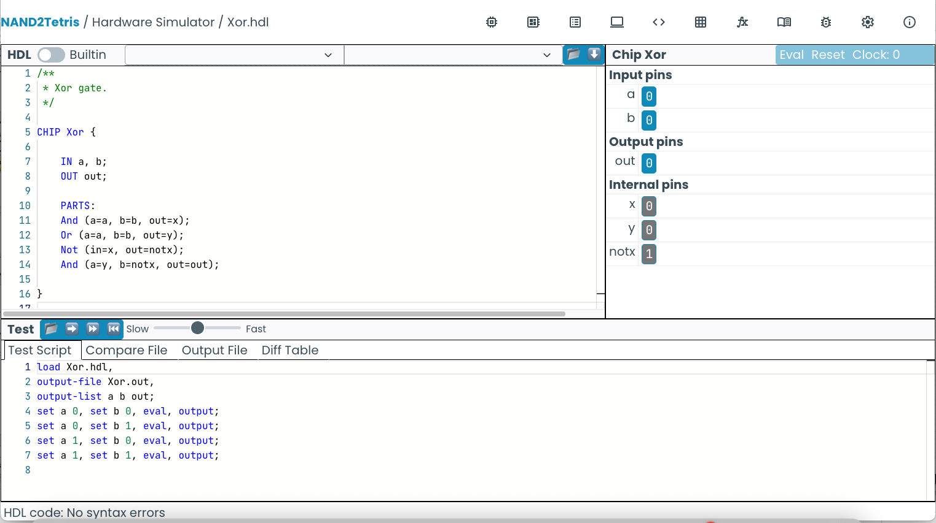
Script-based Testing
HDL code
inspect the output file
2. Run script step by step
test script

Slide 23
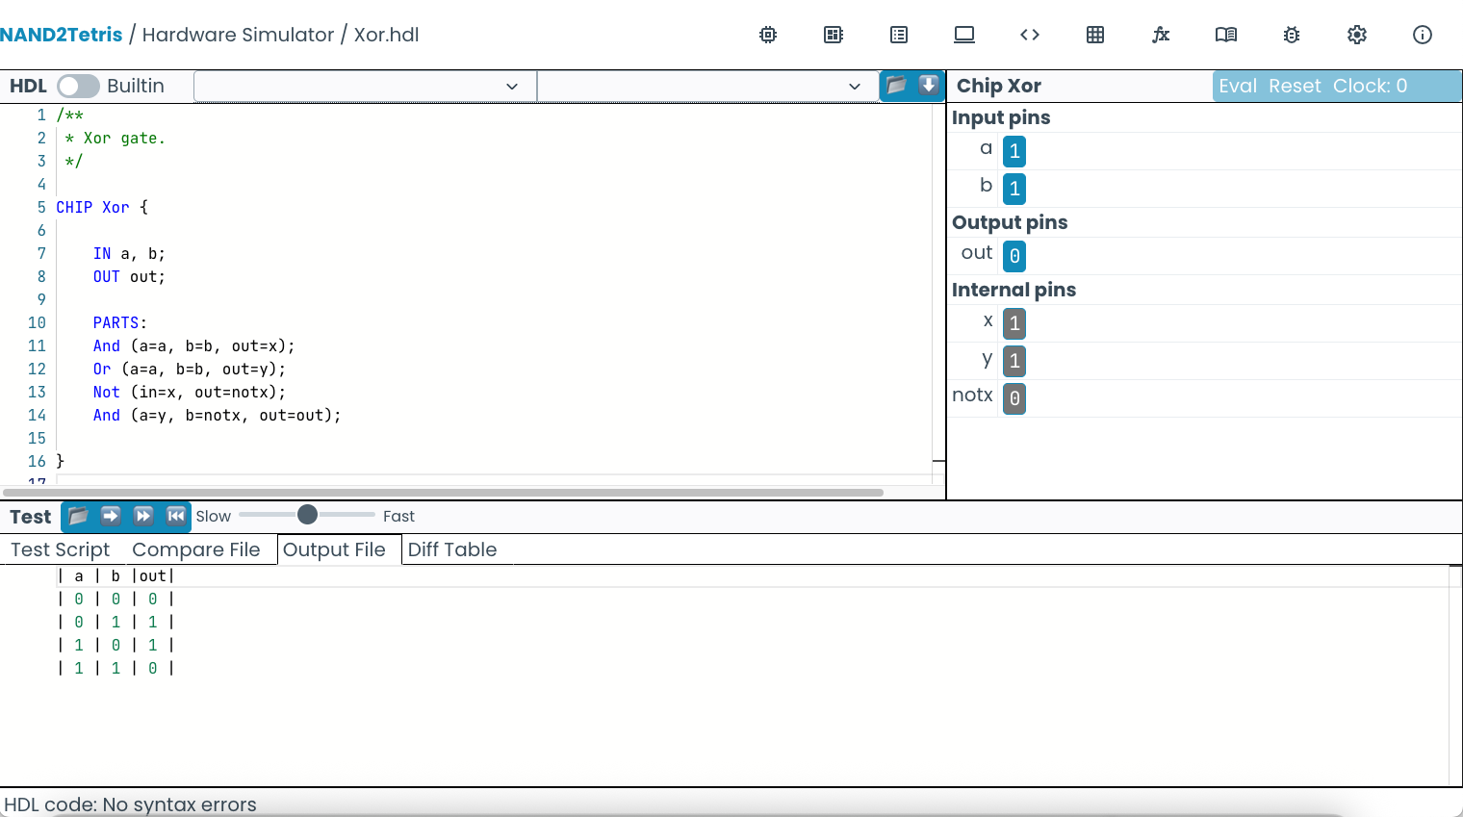
Script-based Testing
HDL code
Xor.out
| a | b |out|
| 0 | 0 | 0 |
| 0 | 1 | 1 |
| 1 | 0 | 1 |
| 1 | 1 | 0 |
Output file

Slide 24
Your turn
在文本编辑器（文本编辑，VS代码）中为您的第一个芯片（first.tst）创建测试脚本
然后将脚本加载到模拟器中。（您需要刷新浏览器，以便文件显示在列表中。）
在模拟器中运行测试脚本，查看它是否产生预期的输出
first.out
| A | B | O |
| 0 | 0 | 1 |
| 0 | 1 | 0 |
| 1 | 0 | 0 |
| 1 | 1 | 1 |

Slide 25
Script-based Testing
Xor.tst
使用比较文件逻辑进行模拟
当执行每个输出命令时，将输出的行与比较文件中的相应行进行比较
如果两条线不相同，模拟器会抛出比较错误。
请注意，每列中的空格也必须匹配！
load Xor.hdl,
output-file Xor.out,
compare-to Xor.cmp,
output-list a b out;
set a 0, set b 0, eval, output;
set a 0, set b 1, eval, output;
set a 1, set b 0, eval, output;
set a 1, set b 1, eval, output;
Xor.out
Xor.cmp
| a | b |out|
| 0 | 0 | 0 |
| 0 | 1 | 1 |
| 1 | 0 | 1 |
| 1 | 1 | 0 |
| a | b |out|
| 0 | 0 | 0 |
| 0 | 1 | 1 |
| 1 | 0 | 1 |
| 1 | 1 | 0 |
compare

Slide 26
Your turn
1) In a text editor create a compare file for your first chip.
It should look like the following.
2) Update your first.tst file to include a compare file.
3) Run your script in the simulator and check that all comparisons are passed.
first.cmp
| A | B | O |
| 0 | 0 | 1 |
| 0 | 1 | 0 |
| 1 | 0 | 0 |
| 1 | 1 | 1 |

Slide 27
Your turn
Now have a go at implementing the Half and Full Adders from Lecture 1.4.1.
  我们为文件HalfAdder.hdl和FullAdder.hdl以及所需的测试和比较文件提供了一个模板。
  提示：您可以使用您在其他HDL文件中创建的芯片。因此，一旦你创建了HalfAdder.hdl，你就可以将该芯片包含在FullAdder.hdl文件中，而无需复制hdl（因为HalfAdder 的芯片名称和文件名一致，所以能找到）
  Putting
  HalfAdder(a=a, b=b, sum=s1, carry=c1);
  in your FullAdder.hdl will include a Half Adder with pin names a and b and output pin names s1 and c1.
  Below is a reminder of the circuits.

Slide 28
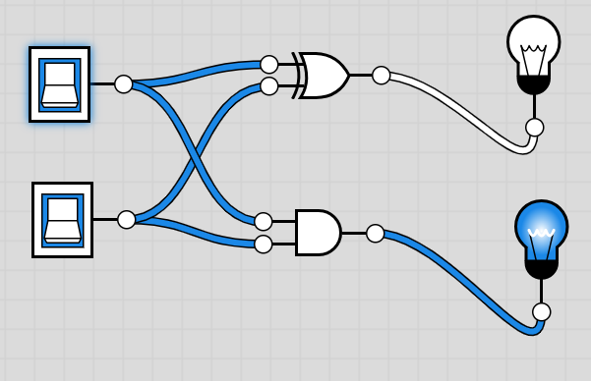
Your turn
Half Adder (HalfAdder.hdl)
Note the case of the pin names used for the inputs and outputs
a | b | sum | carry
0 | 0 | 0 | 0
0 | 1 | 1 | 0
1 | 0 | 1 | 0
1 | 1 | 0 | 1

Slide 29
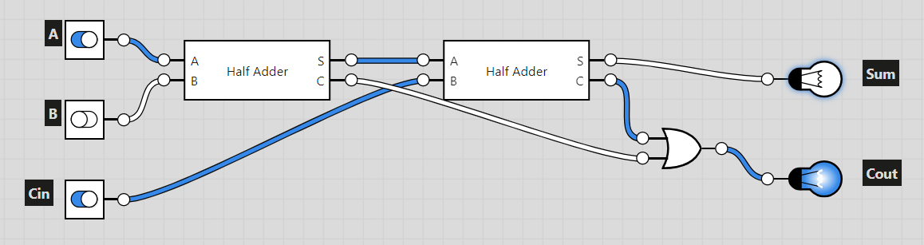
Your turn
a | b | c | sum | carry
0 | 0 | 0 | 0 | 0
0 | 1 | 0 | 1 | 0
1 | 0 | 0 | 1 | 0
1 | 1 | 0 | 0 | 1
0 | 0 | 1 | 1 | 0
0 | 1 | 1 | 0 | 1
1 | 0 | 1 | 0 | 1
1 | 1 | 1 | 1 | 1
Full Adder (FullAdder.hdl)
Note the names and case used for the input and output pins in the table

Slide 30
Your turn
Two binary numbers, a and b, each of two digits, are represented as a₁a­₀ and b₁b₀ where a₁, a₀ and b₁, b₀ are Boolean variables which form the digits of the binary numbers.
Devise a combinatorial logic circuit, or circuits to provide outputs of X,Y, Z such that X=1 when a>b, Y=1 when a<b and Z=1 when a=b.
Start by constructing the 3 truth tables for the outputs X,Y and Z with inputs a1, a0, b1 and b0.
Derive(推导) the Boolean expressions for X,Y,Z from the truth table.
用Kmap化简表达式
Implement the circuits in HDL. We have provided a template, test and cmp file for you, comparator.hdl, comparator.tst and comparator.cmp.

Slide 31
Summary
Introduced Computer Aided Design (CAD) and Hardware Description Language (HDL)
Introduced a hardware simulator
Learnt how to write HDL files
Learnt how to run simulations of simple logic circuits
Implement the first two chips required for our HACK computer (HalfAdder and FullAdder)

